Slide 1

“Real-time Chat
Application”
Task - 1

Slide 2





LMS Username Name Batch
the requirements and specifications for building a real-time chat application using Node.js. This application will allow users to communicate with each other in real-time, send files and images, and create group chats.
2108a33277
2108a33282
Joel T George A33
Magesh V
Mohamad Nazeer Khan S
A33
A33
2108a33285
2108a33293
Rushil S L P
A33

Slide 3



time chat application using Node.js.
requirements and specifications for building a real-
This application will allow users to communicate with each other in real-time,
send files and images, and
create group chats
Functional Requirements:
User Registration and Login User Profile
Real-time Chat
File and Image Transfer Group Chat Notification
Search Functionality

Slide 4

Functional Requirements:
User Registration and Login
Users should be able to register and create an account to access the chat application. After registration, users should be able to log in with their credentials.
User Profile
Users should be able to view and edit their profile information such as their name, profile picture, and status.
Real-time Chat
The chat application should allow users to send and receive real-time messages to other users in the system. Users should be able to view their conversation history and search for messages.
File and Image Transfer
Users should be able to send and receive files and images in the chat. The application should support common file formats and provide a preview of images.

Slide 5
Functional Requirements:
Group Chat
Users should be able to create and join group chats with other users in the system. Group chats should have a unique name and a list of members. Users should be able to view the conversation history of the group chat.
Notification
Users should receive notifications when they receive new messages or when they are invited to join a group chat. Notifications should be displayed in real-time, and users should be able to control their notification settings.
Search Functionality
Users should be able to search for other users in the system and join their chat. Users should be able to search for group chats and join them if they have permission.

Slide 6


Non-Functional Requirements
chat application should be able to handle a large number of users and messages without slowing down.
The application should be optimized for performance and scalability.

Slide 7

Performance
The chat application should be able to handle a large number of users and messages without slowing down. The application should be optimized for performance and scalability.
Non-Functional Requirements
Security
The chat application should use secure authentication and encryption to protect user data and prevent unauthorized access. User data should be stored securely and protected from data breaches.

Slide 8
Usability
The chat application should have an intuitive and user-friendly interface. Users should be able to navigate the application easily and perform tasks quickly.
Non-Functional Requirements
Availability
The chat application should be available 24/7 with minimal downtime for maintenance or updates. The application should be able to handle high traffic and usage.

Slide 9

Technical Requirements
the real-time chat application using Node.js,
Web-Sockets for real-time communication,
Sqlite for data storage,
Express.js as the web framework,
WS library for real-time event-based
communication,

Slide 10
Technical Requirements
Node.js
The chat application should be built using Node.js, a JavaScript runtime that allows for server-side scripting.
WebSockets
The chat application should use WebSockets to enable real- time communication between users. WebSockets allow for bi- directional communication between clients and servers.
SQLite
The chat application should use SQlite, a SQL database, to store user information and chat history. Future change MySQL for scalable and flexible database that is ideal for real-time applications.
Express.js
The chat application should use Express.js, a web framework for Node.js, to handle server-side operations. Express.js is a lightweight and flexible framework that allows for rapid development.

Slide 11


Constraints
Compatibility
The chat application should be compatible with all modern web browsers, including Google Chrome, Mozilla Firefox, Apple Safari, and Microsoft Edge.
Scalability
The chat application should be able to scale to accommodate a large number of users. The application should be able

Slide 12
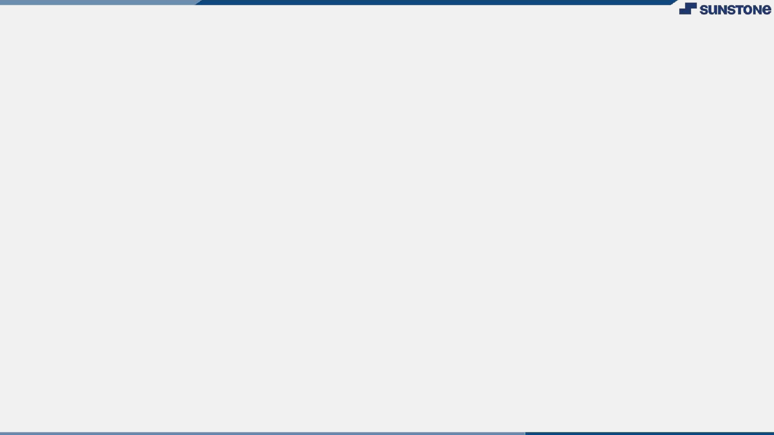

. Conclusion .
This Software Requirement Specification document outlines the requirements and
specifications for the development of a real- time chat application using Node.js. By following these guidelines, the development team can ensure that the application meets the needs of the users and delivers a high-quality
experience.

Slide 13
Real Time Chat Application Click Here
Submission Github

Slide 14


